Slide 1
Python Fundamentals - Day 1
Data types, Data structures, Conditionals and Loops

Slide 2
About Me
Current: PhD student in Biomedical Health Informatics (2nd Year), specializing in Medical Data Science and Software Design.
Education: MS in CS from the University of Wisconsin-Milwaukee.
Recent to Past Experiences:
- Graduate Teaching Assistant at UWM – Computer Science department (2018 - present).
- Artificial Intelligence Intern at NeoSoft (May 2022 - December 2022)
- Software Engineer at Pearson Vue (2016 - 2018).
- Java Developer at LexisNexis Risk Solutions (2015 - 2016).

Slide 3
Basic Data Types
Integer (int): Integers are whole numbers without any fractional or decimal parts. For example: -5, 10, 0
Floating point number (float): Floating point numbers represent real numbers with both integer and fractional parts. They are written with a decimal point. For example: 3.14, -0.5, 2.0

Slide 4
Basic Data Types cont.
String (str): Strings are sequences of characters enclosed in single ('') or double ("") quotes. They are used to represent text. For example: "Hello,world!", 'Python'.
Boolean (bool): Booleans represent truth values. They can have two possible values: True or False. Booleans are often used in conditional statements and logical operations.

Slide 5
Basic Data Types - Example 1
Here's a basic exercise involving Python's basic data types. Let's start with some questions and tasks:
Create a variable called name and assign it your name as a string.
Create a variable called age and assign it your age as an integer.
Create a variable called height and assign it your height in meters as a float.
Create a variable called is_student and assign it a boolean value indicating whether or not you are currently a student.
Print the values of all the variables you created in the previous steps.

Slide 6
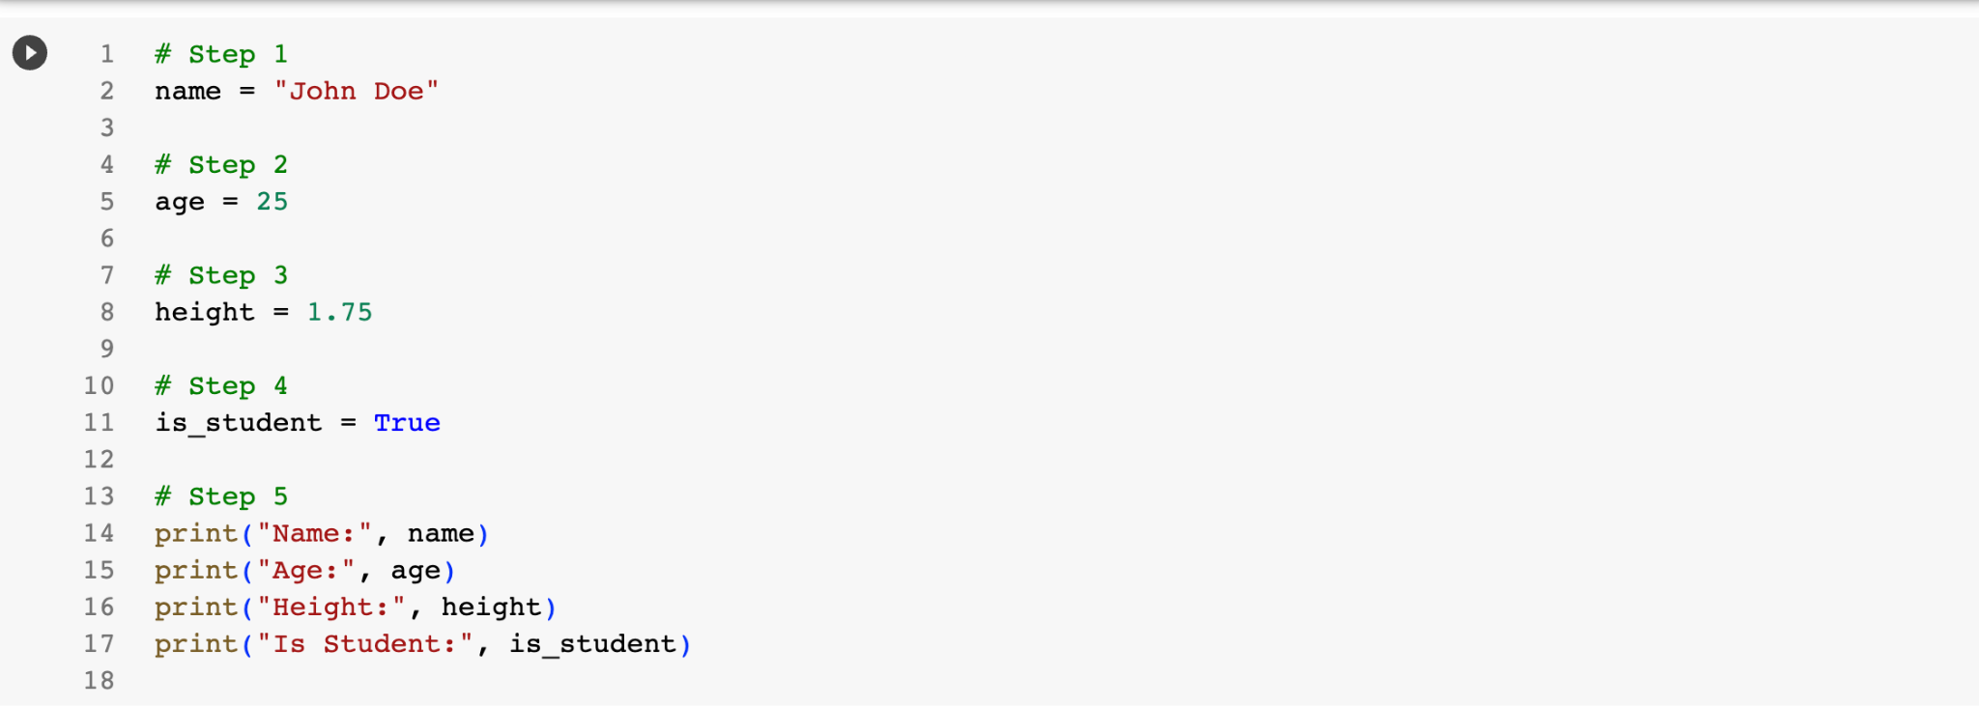

Slide 7
Basic Data Types - Example 2
Create a Python program that performs the following tasks:
Define three variables: name, age, and height.
Assign your own values to these variables, representing your name, age, and height.
Print out the values of these variables using the print function.
Use the type function to determine the data type of each variable and print the results.

Slide 8
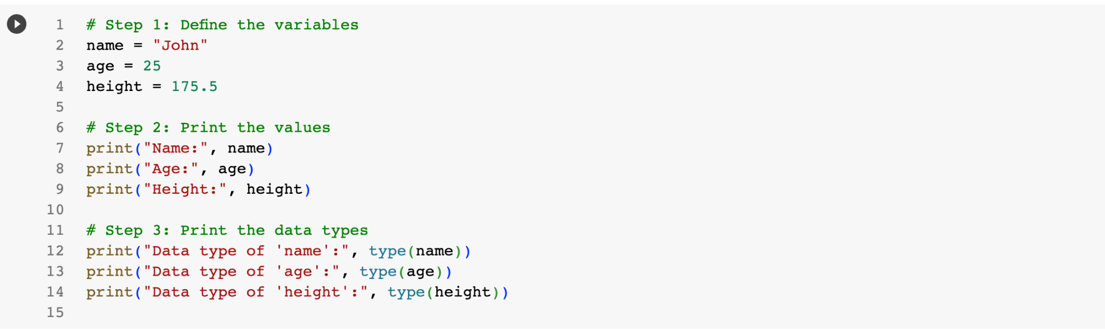

Slide 9
Data Structures
List: Lists are ordered collections of items, enclosed in square brackets ([]). They can contain elements of different types and are mutable, meaning you can change, add, or remove items from them.
Tuple: Tuples are similar to lists, but they are immutable, meaning they cannot be modified once created. Tuples are defined using parentheses (()).

Slide 10
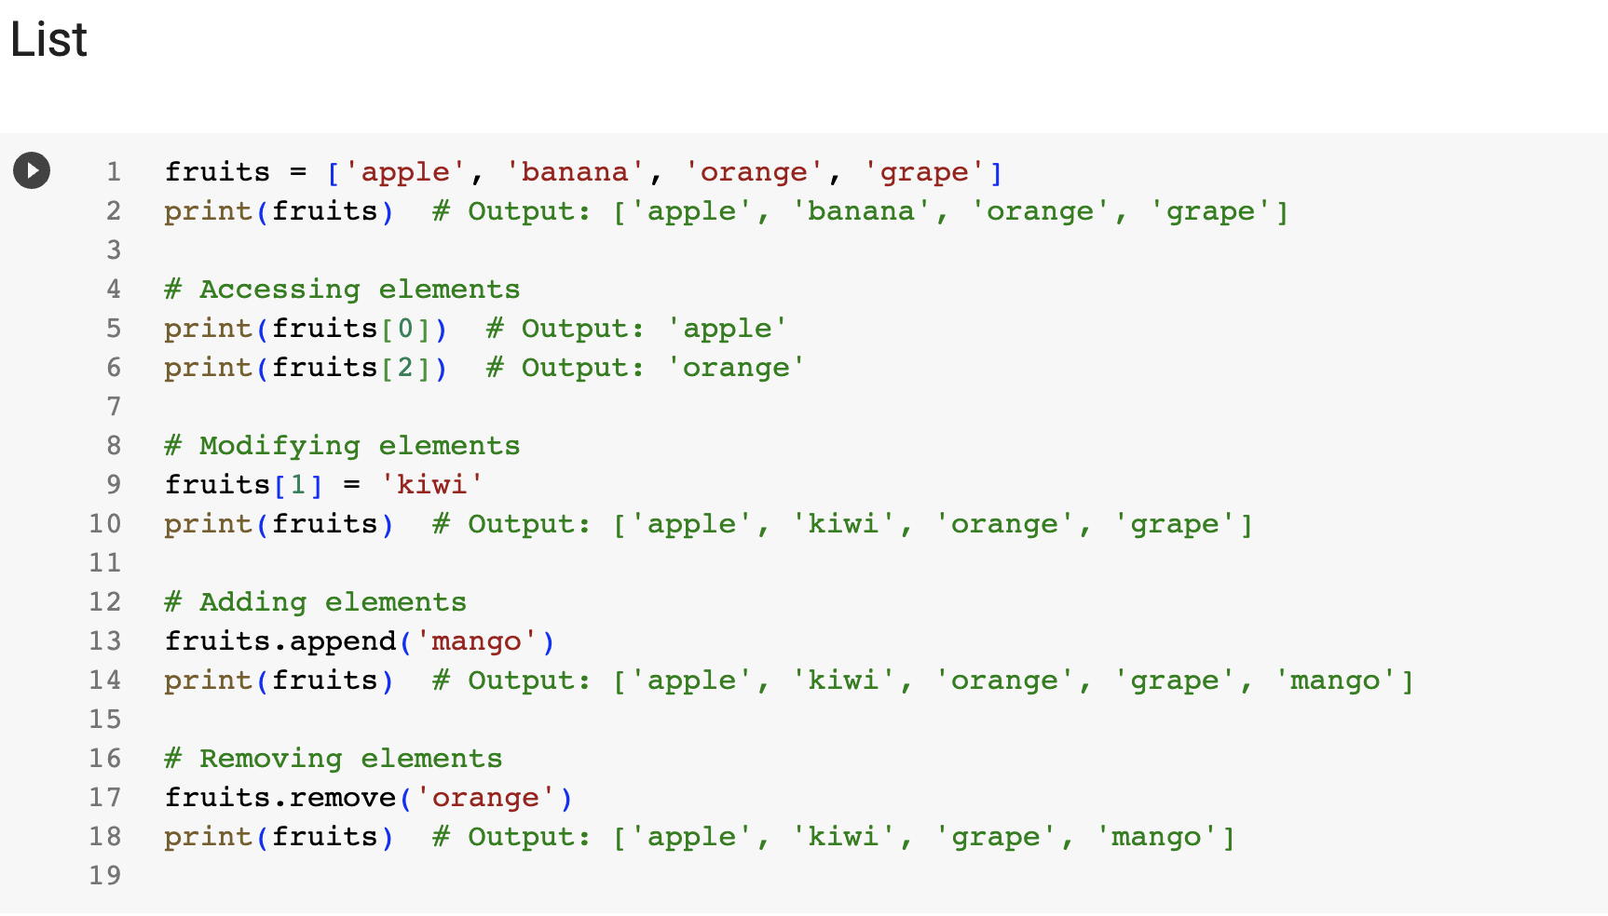

Slide 11
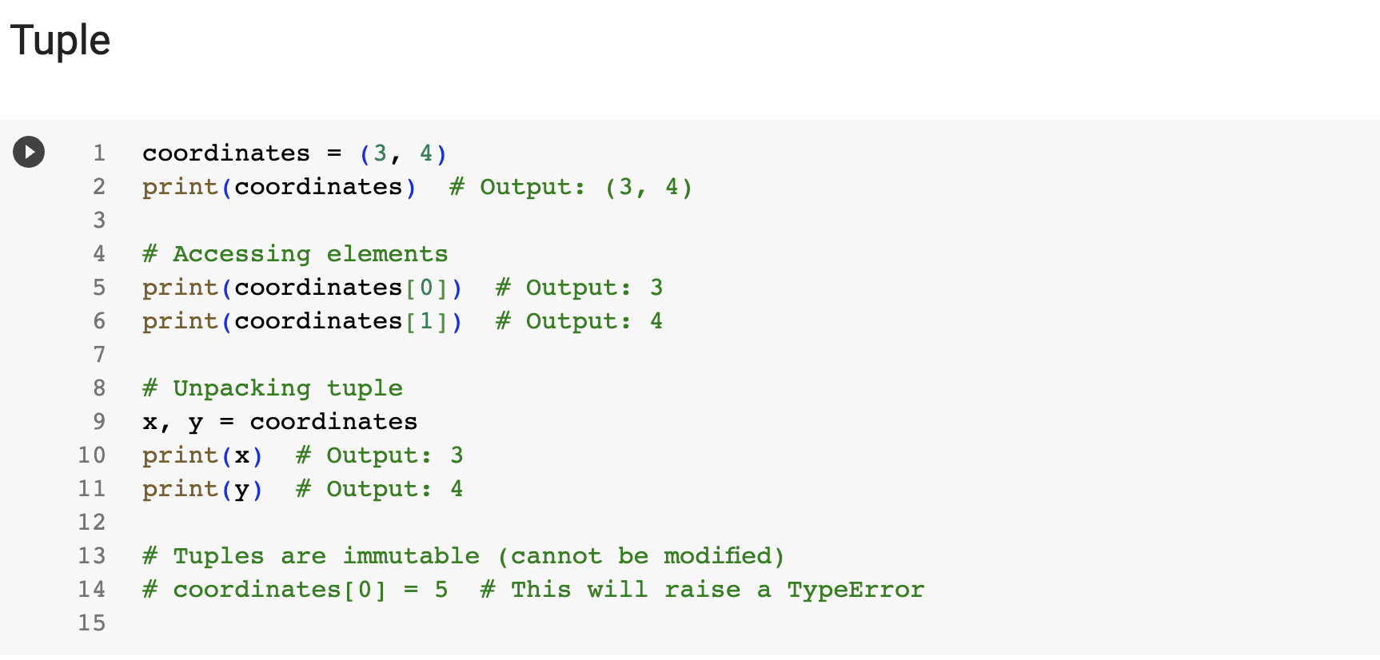

Slide 12
Data Structures cont.
Dictionary: Dictionaries are unordered collections of key-value pairs. Each key is associated with a value, and you can use the key to access the corresponding value. Dictionaries are defined using curly braces ({}) and colons (:).
Set: Sets are unordered collections of unique elements. They are useful for operations like union, intersection, and difference. Sets are defined using curly braces ({}) or the set() function.

Slide 13
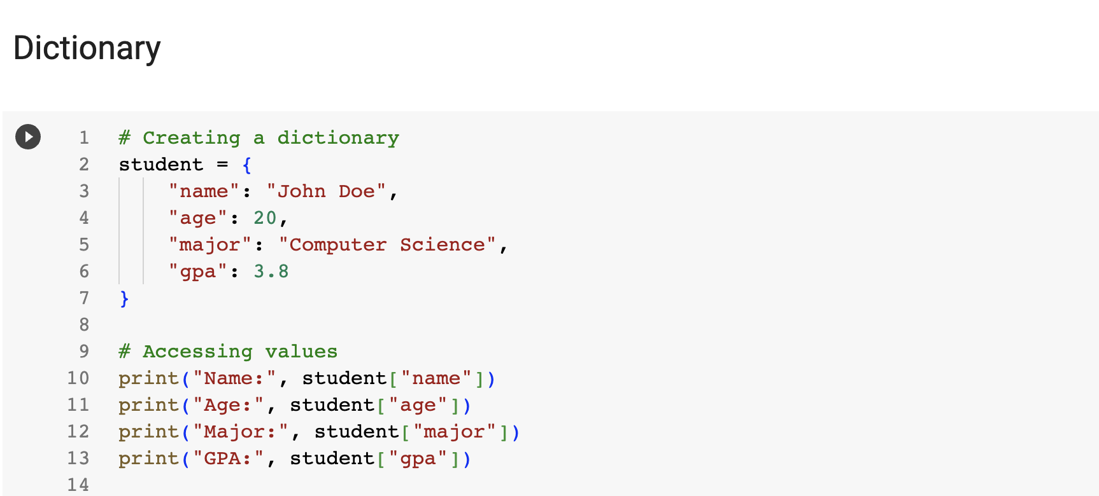

Slide 14
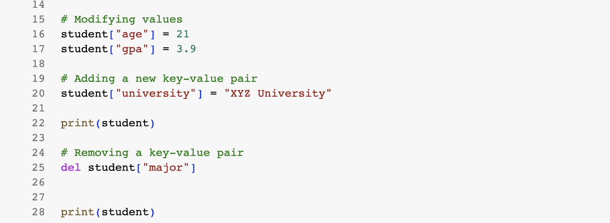

Slide 15
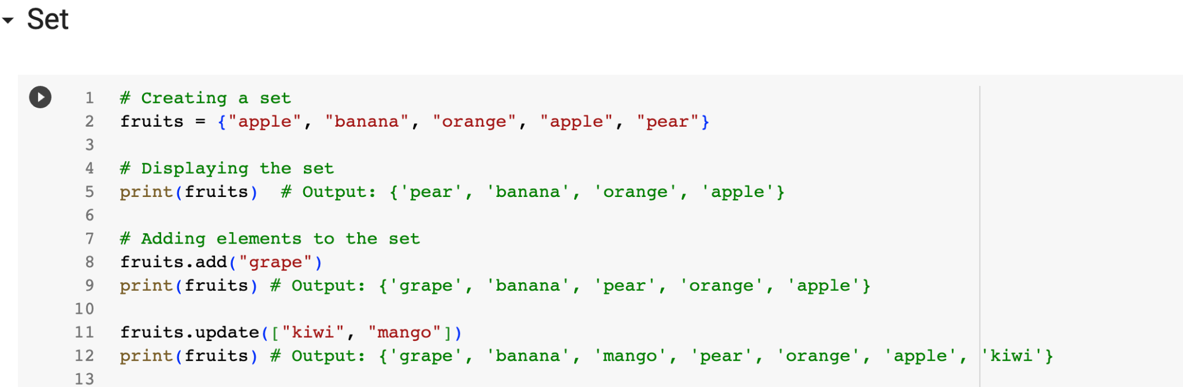

Slide 16
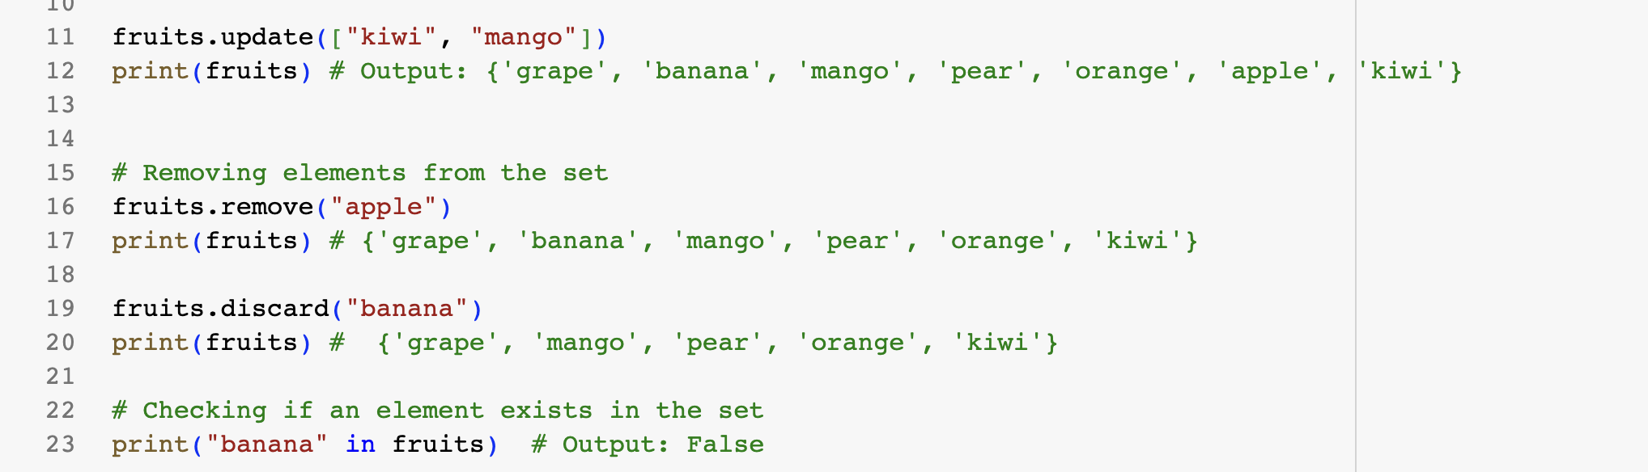

Slide 17
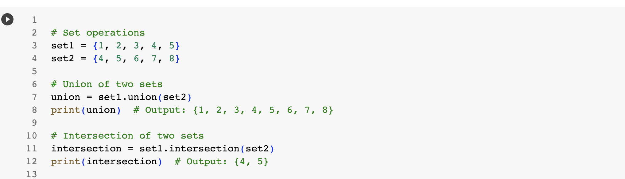

Slide 18
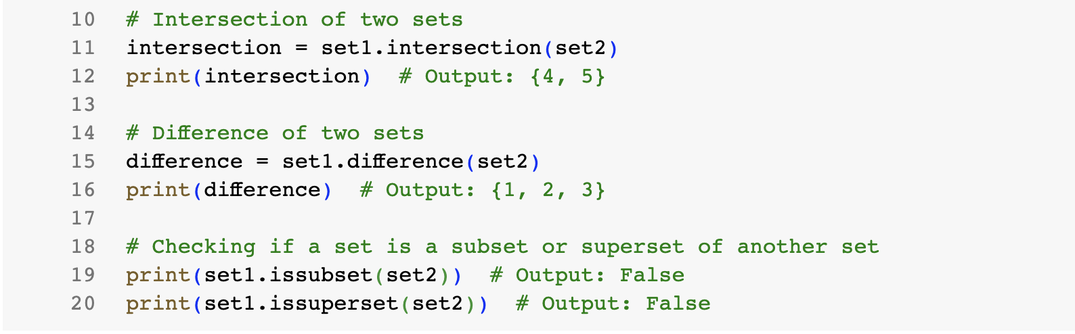

Slide 19
Control Flow: Conditionals, Loops
Conditionals and for loops are fundamental constructs in Python that allow you to control the flow of your program and perform repetitive tasks.
Conditionals (if-elif-else statements): Conditionals allow you to make decisions in your code based on certain conditions. In Python, the if-elif-else statement is used to implement conditionals.

Slide 20
Control Flow: Conditionals, Loops cont.
if condition1:
# code to execute if condition1 is True
elif condition2:
# code to execute if condition2 is True
else:
# code to execute if neither condition1 nor condition2 is True

Slide 21
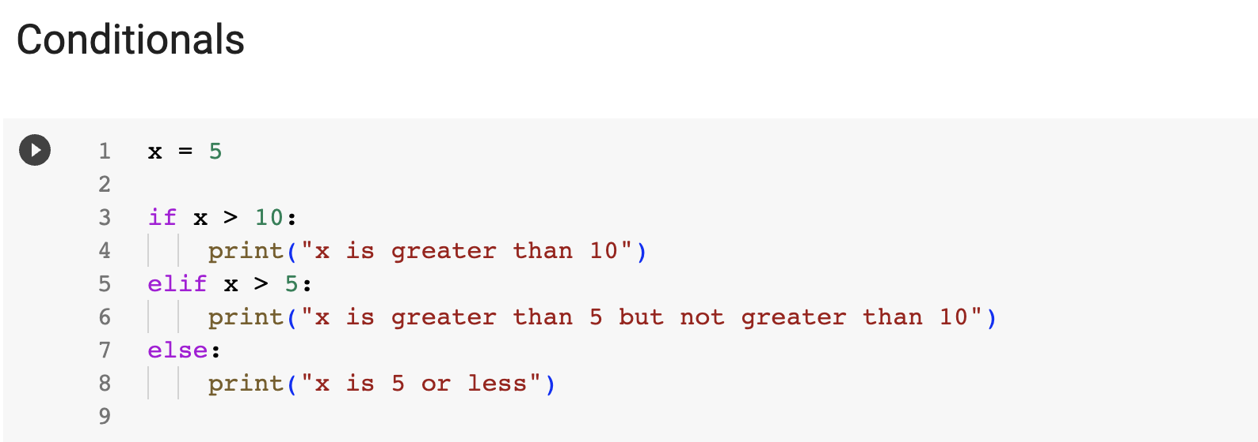

Slide 22
Control Flow: Conditionals, Loops cont.
For Loops: For loops allow you to iterate over a sequence (such as a list, tuple, or string) or any iterable object in Python. The basic syntax is as follows:
for item in sequence:
# code to execute for each item in the sequence
The for keyword is used to start the loop.
item is a variable that represents the current item in the sequence for each iteration.
sequence is the iterable object that the loop iterates over.

Slide 23
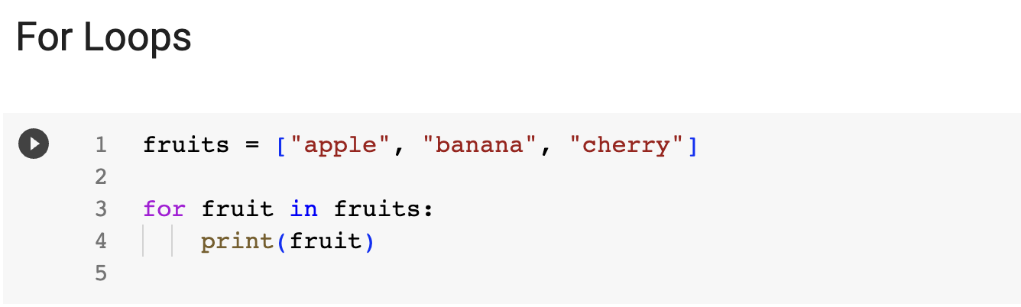

Slide 24
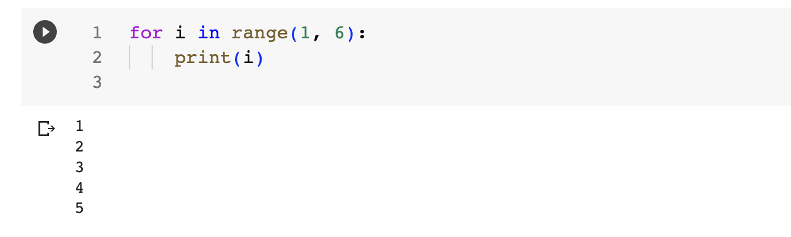

Slide 25
Control Flow: While Loops
The while loop in Python allows you to repeatedly execute a block of code as long as a certain condition remains true. It is useful when you want to perform a task repeatedly until a specific condition is met.
The basic syntax of a while loop is as follows:
while condition:
# code to execute while the condition is True

Slide 26
Control Flow: While Loops cont.
The while keyword is used to start the loop.
condition is an expression that is evaluated before each iteration. If the condition is true, the code block under the while loop is executed.
If the condition is false, the program exits the loop and continues with the next line of code after the loop.

Slide 27
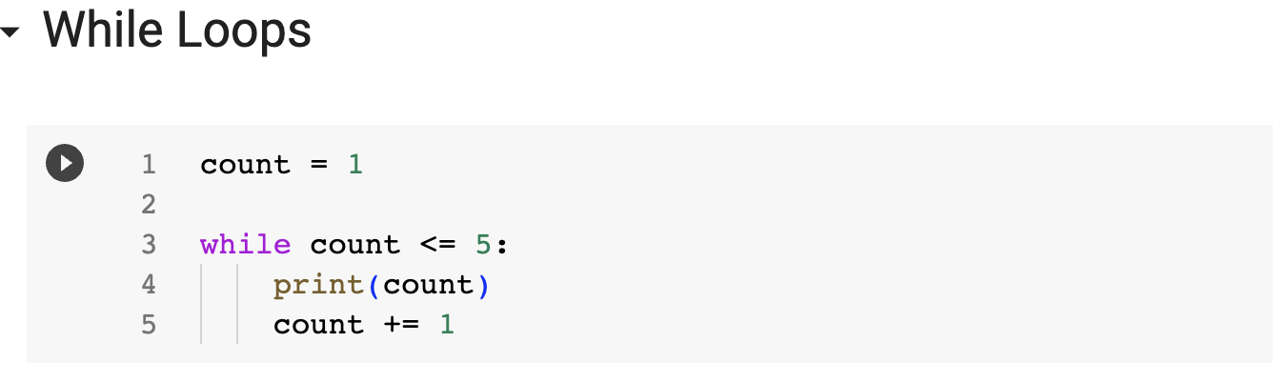

Slide 28
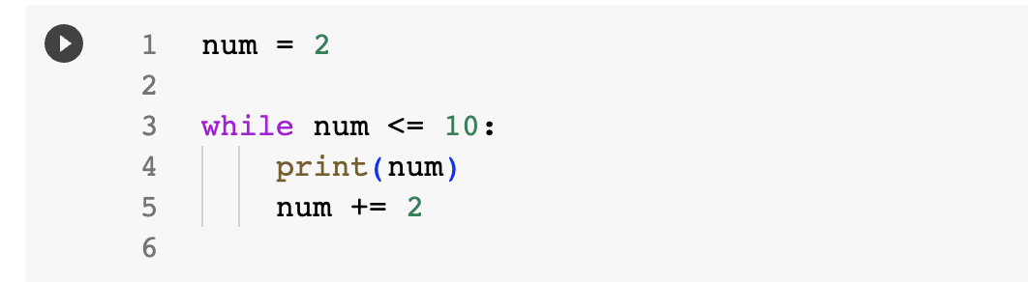

Slide 29
Code Demo: Student Scores
Write a Python program to store and manipulate student scores. The program should have the following functionalities:
Initialize an empty dictionary to store the student scores.
Allow the user to add a new student's name and their score.
Display the current list of students and their scores.
Determine and display the highest score and the corresponding student.

Slide 30
Code Demo: Student Scores cont.
Instructions:
Use a dictionary to store the student names as keys and their scores as values.
Use a list to keep track of the students in the order they are entered.

Slide 31
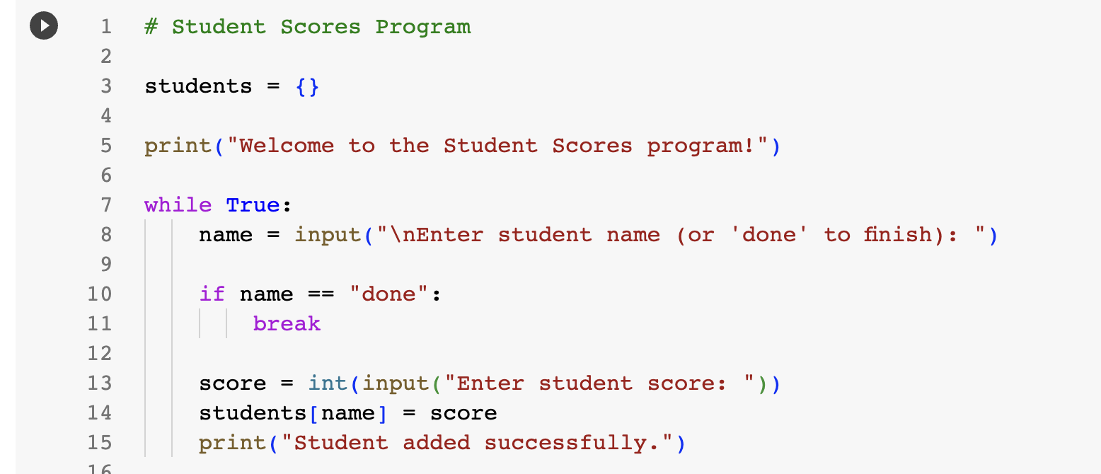

Slide 32
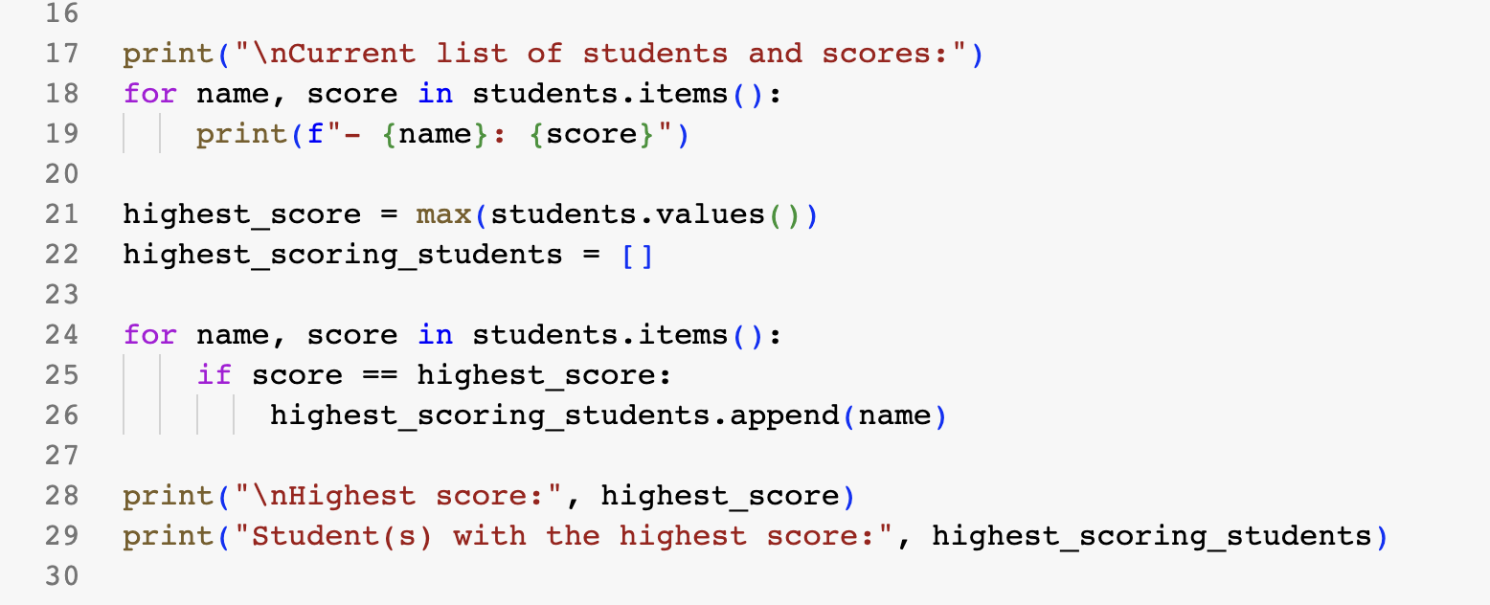

Slide 33
Exercise 1: Shopping Cart
Link: https://docs.google.com/document/d/1xgePh5s0JjyEaf2eFY85l0vNmDzlOY6IUHXyxAAgBSY/edit?usp=sharing

Slide 34
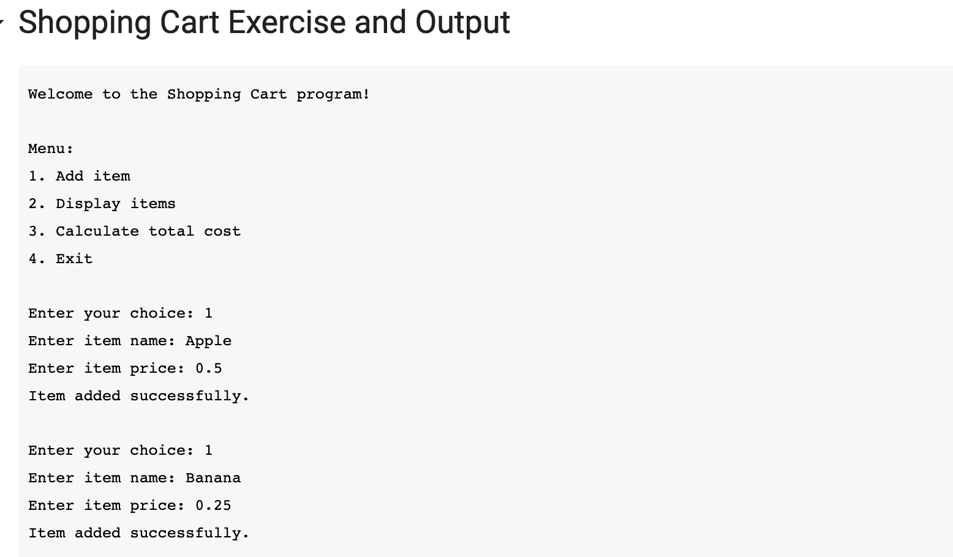

Slide 35
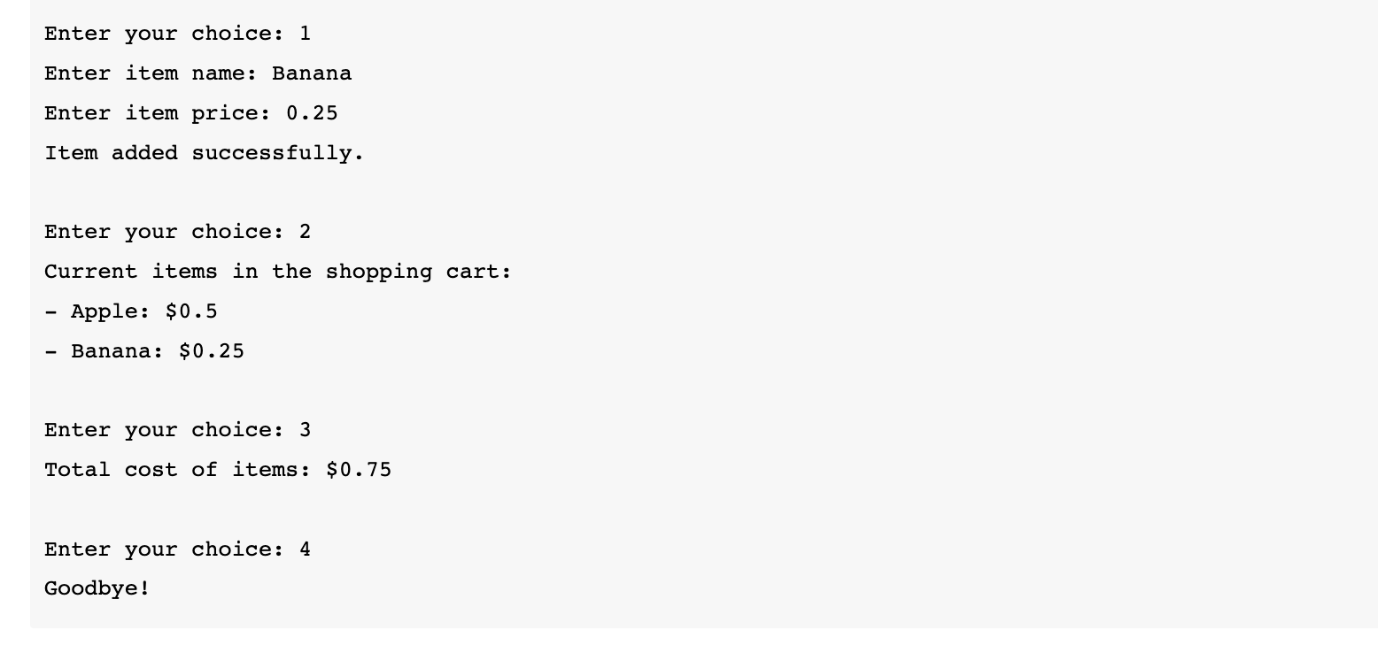

Slide 36
Exercise 2: Word Frequency Analyzer
Link: https://docs.google.com/document/d/1WlCSMTpFk_z5oq9CF7rmax1b50wFyKiZ5XaR5vIB-Nc/edit?usp=sharing

Slide 37
Exercise 3: Task List
Link: https://docs.google.com/document/d/1fHczgGEWIXkFFTc5jJWMX5IgVH_KmuV_17Uqwm5h-6A/edit?usp=sharing

